Slide 1
Entomology: Bugs Assorted
Type 1 Bugs: If the program does not run at all. Then…
MAKE IT RUN.
Type 2 Bugs: If the program runs, but gives an “incorrect” output. Then…
CHECK PROCEDURES
Notes:
You can have this two type of bug.

Slide 2
Before Debugging: Strategy
Understand the problem
If we do not understand the task the program is supposed to solve, then… we will NEVER be able to make a correct program
It is always important to re-read and find more material on the problem to solve before start programming task.
Notes:
Common points can be:
Print intermediate steps on the screen while writing the script
Use a sandbox folder (eg github)
Use artificial or copied data (final results known, for comparisons)

Slide 3
Before Debugging: Strategy
Think about the assumptions and work with examples
Start with sketching one or more examples on input and output of the program. Is useful for controlling the understanding the purpose of the program, and verifying the implementation
Make sure we are editing the version of the program that you we are actually using
Save changes before re-execute.
Check line endings. Incorrect line endings in input files → program can combine data lines.
Notes:
Assuring the correct version of the program that we use helps editing wrong scripts. Hint: use which command to get the absolute path of the program
InFile = open(InFileName, ‘rU’) converts all line endings to newline (\n) characters

Slide 4
Before Debugging: Strategy
Decide on a user interface
Make Algorithms
Look up information
Notes:
Decide on a user interface Find out how we want to get data into the program. Grab data from the command-line? A file? A dialog with questions and answers? Make Algorithms Identify the key tasks to be done in the program and sketch “rough” algorithms for these. Piece of paper and pseudocode? IS USEFUL! Is easy to develop into “real” Python code later. Look up information Manuals, books, internet, friends on Crowd Course… We need to know and understand the basic constructs, and some problem-solving techniques, learn from existing examples…

Slide 5
Before Debugging: Strategy
Write the program
Run the program
Notes:
We have all the necessary material, we studied how to approach the problem and reviewed the assumptions on which it is based, we have chosen the user interface we'll use ... as we turn to the most beautiful part: write the program and run it . Wow!

Slide 6
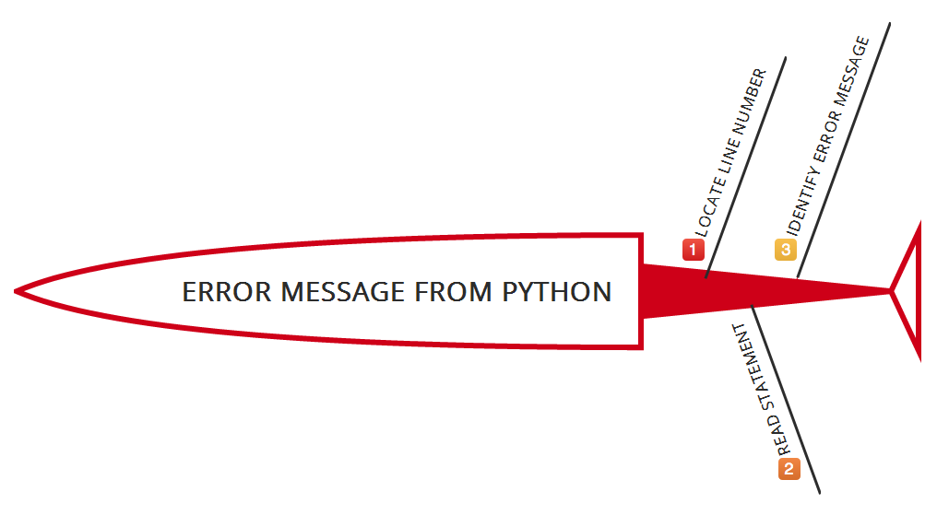
Run the program: Common error messages
If the program aborts with an error message from Python, these messages are fortunately quite precise and helpful.

Slide 7
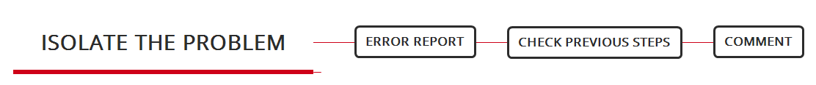
Run the program: Common error messages
Isolate the problem
Notes:
Isolate the problem * Error report. Reported line often does not contain error.
* Then, check previous steps. * Comment in/out sections with #, or ‘’’...’’’, or “””...””” triple quotes for multiple lines * #... Comment on what we write

Slide 8
Run the program: Common error messages
/Users/afelio/scripts/myprogram.py: line 3: import command not found
Problem with python program,
Perhaps problems with shebang line: #!
Misspelled built-in Python function within the program

Slide 9
Run the program: Common error messages
Bad interpreter not a directory
#! Has a / after /usr/bin/env/
Permission denied
Chmod u+x, as explained before

Slide 10
Run the program: Common error messages
r /usr/bin/env: bad interpreter: No such file or directory
Some part in our #! Statement not found.
→ Copy in statement into the terminal, and see if it launches Python.

Slide 11
Run the program: Common error messages
Name ‘x’ is not defined
Misspelled variable name in the program
Variable not originally defined
→ Initialize variable, eg MyList=[] , or MyString=” “
Function used, but not imported from a module first
Function used without the required module name in “dot” notation eg Radint(5) instead of random.radint(5)

Slide 12
Run the program: Common error messages
Indentation error
4 commas vs 1 tab
Attribute error
Misspelling of a built-in function, eg MyString.lowercase() instead of Mystring.lower()
Type error ‘xx’ object is not callable
Want to get values from a List() and not List[], wrong interpretation as a function and not a list

Slide 13
Run the program: Common error messages
Traceback … zero division error
Division by zero!!
Function returns “unexpected” zero.
Input data with 0 → check user and variable input, to be non-blank, non-zero, …
Non-ASCII character ‘xe2’ in file
Or avoid non-ASCII character, or type # coding: utf-8 below the #! Line
Invalid syntax
All things possible: Missing colon after if, else, or for statement
Missing close parenthesis, brackets, = instead of ==

Slide 14
Beyond error messages: Kinds of Errors
Main kinds of errors:
Syntax errors
Exceptions
Notes:
We have seen various types of messages and situations against those who (too often) we had to fight. However, there are (at least) two distinguishable kinds of errors: syntax errors and exceptions.

Slide 15

Syntax errors
Syntax errors, aka parsing errors, are perhaps the most common kind of errors.
Hint: see the little arrow, near the error site.
Notes:
The parser repeats the “error line” and displays a little “arrow ^” pointing at the earliest point in the line where the error was detected. The error is caused by (or at least detected at) the token preceding the arrow: in the example, the error is detected at the keyword print, since a colon (':') is missing before it. File name and line number are printed so we know where to look in case the input came from a script.

Slide 16
Syntax Errors: Invalid syntax
In short: Python “grammar” errors
Forgetting the parentheses around the arguments to print
Forgetting the colon at the end of the condition in an if statement
Trying to use a reserved word as a variable name .
Notes:
The syntax of a language is the set of rules that define what parts of the language can appear in which places. If you insert tab A into slot B, so to speak, you'll create a statement that has invalid syntax. Because there are lots of slots in Python that don't accept most tabs, generating a syntax error is not hard.
Here are some common errors that cause this message:
Forgetting the parens around the arguments to print
Forgetting the colon at the end of the condition in an if statement
Trying to use a reserved word as a variable name

Slide 17
Syntax Errors
Misspelling Python keywords
1 counter=0 2 While counter < 5: 3 print "hello" 4 counter = counter + 1 Traceback (most recent call last): File "./tester.py", line 2 While counter < 5: ^ SyntaxError: invalid syntax
Notes:
Python is case sensitive. This includes keywords (like "def", "for" and "while") as well as variable names.
In the following example, the "while" keyword has been incorrectly spelt with a capital "w". Note that in this case, the error message is a little
misleading since the arrow points to the wrong part of the code

Slide 18
Syntax Errors
Missing off a colon from the end of an if or while line
1 counter = 0 2 if counter == 4 3 print "counter is 4" File "tester.py", line 2 if counter == 4 ^ SyntaxError: invalid syntax
Notes:
In the example, a colon is missing from the end of the if conditional line.

Slide 19
Syntax Errors
Wrong number of brackets in function calls or expressions
1 x = 3 2 y = ((x + 3) * (x + 4) 3 print y File "tester.py", line 3 print y ^ SyntaxError: invalid syntax
Notes:
In the example, a bracket is missing to complete the expression at the end of the line. Note that the error message points to the line below where the error actually occurs.

Slide 20
Syntax Errors
Missing quotation marks
1 greeting = "hello" + " world 2 print greeting File "tester.py", line 1 greeting = "hello" + " world ^ SyntaxError: EOL while scanning single-quoted string
Notes:
n this example, the literal "world" is missing a closing quotation mark. If you read the error carefully (in which 'EOL' means 'End of Line'), you will see it is saying that it found the end of the line while scanning through a string - and this is a problem because we need the closing quote on the same line. Always try to get information from the error message.

Slide 21
Syntax Errors
Incorrect indentation
1 x = 0 2 y = 1 File "tester.py", line 1 x = 0 ^ SyntaxError: invalid syntax
Notes:
Sometimes, Python will report indentation problems as syntax errors. Python uses indentation to show where each block of code begins and ends. Indentation can be achieved with spaces or tabs, but a mixture will almost always lead to confusion and errors. Since a tab and 4 spaces look the same on the screen, two pieces of code can look identical to you, but to Python they look entirely different. This is the cause of many non-obvious errors. If your code looks perfect but is still giving syntax errors, check that your indentation is correct.

Slide 22
Syntax Errors Vs. Runtime Errors
If syntax errors were just typing mistakes they could be found before running a program. But usually it means that something deeper is going on with the program structure.
Runtime errors occur as your program executes. Since Python is an interpreted language, these errors will not occur until the flow of control in your program reaches the line with the problem.

Slide 23
Runtime Errors: Name Error
The Name Error will give us a Traceback message like this:
Traceback (most recent call last): File "C:/Users/John/Documents/Teaching-BU/Python-debugging/test.py", line 7, in main() File "C:/Users/John/Documents/Teaching-BU/Python-debugging/test.py", line 5, in main print hello NameError: global name 'hello' is not defined
Notes:
These messages can seem hard to understand at first. The first part tells you which file had the error. In the example above, the file is test.py and the error occurs on line 7. The next line shows the actual line of code where the error occured. This line executes the main() function. Similarly, the next two lines say that the error occurred on line 5, within main , and that the line with the error is print hello. Lastly, the actual NameError says that global name 'hello' is not defined.
A NameError means that Python tried to use a variable or function name, such as hello based on a previous definition. If it hasn't been defined at this point, you get the error.

Slide 24
Runtime Errors: TypeError
A TypeError you might encounter may look like this:
File "C:/Users/John/Documents/Teaching-BU/Python-debugging/test.py", line 2, in print "I am %d feet %d inches tall" % (5, 2, 5) TypeError: not all arguments converted during string formatting
Or:
File "C:/Users/John/Documents/Teaching-BU/Python-debugging/test.py", line 2, in print "I am %d feet %d inches tall" % (5) TypeError: not enough arguments for format string
Notes:
These errors are caused by not matching the correct number of substitutions into a string format. The string format in both cases requires 2 substitutions. The first error is caused by attempting to substitute 3 arguments, and the second error is caused by trying to substitute 1 argument.

